Slide 1
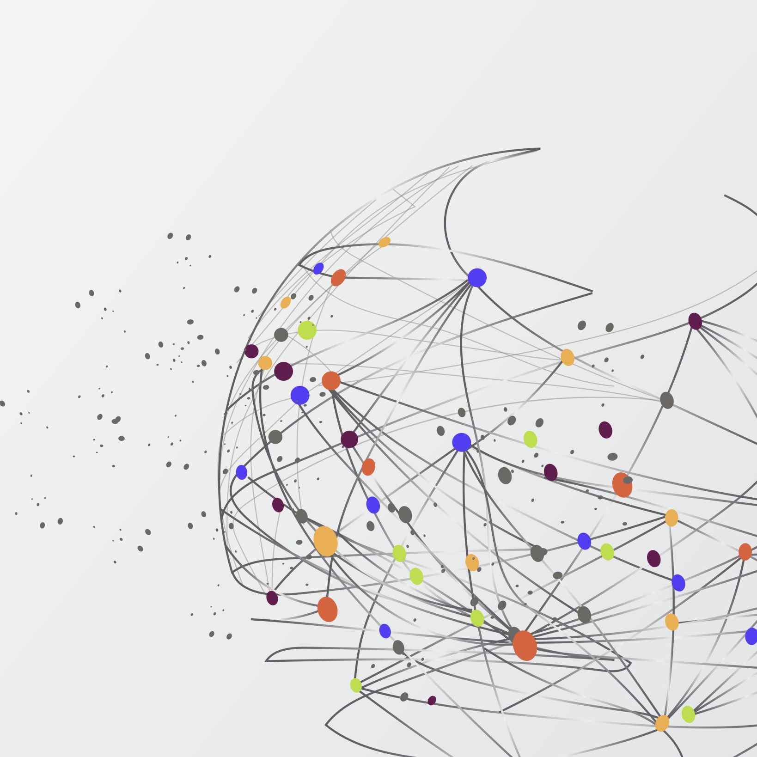
FACE RECOGNITION SYSTEM
By:-Daljeet Singh
&
Priyanka Raghuvanshi

Slide 2
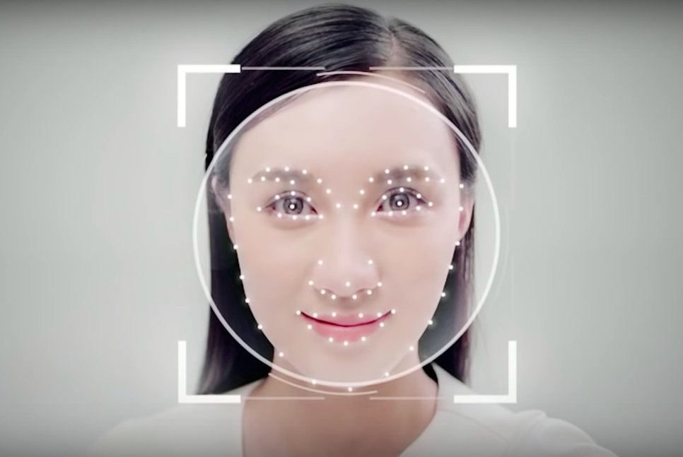
Why face detection?
Due to increase in the day-to-day criminal activities and slow action of our security forces especially police to nab the culprit leading to a less secure society. In India we have seen many 'CCTV' cameras around us which are less in number, and these cameras just record the day-to-day activity in database. It does not provide any alert system for the people from an unknown person. For an instance, the police get an eyewitness who saw a murder or any other crime & he/she knows the face structure of the culprit then the police call a sketch artist to retrieve the image of that person which takes lot more time. Above drawbacks can be overcome by several techniques which are including „Real Time Face Detection‟ in which it recognize the face of suspect or criminal in real time and inform to its nearby police headquarters, secondly „Sketch for Match - 'CBIR' using sketches‟ contains retrieving of face of the suspect or criminal with the help of an eyewitness in less amount of time and lastly the „pattern Matching‟ in which it considers every available evidence and match it with the pattern stored in the database, retrieve the list of suspected people and show it for that crime.

Slide 3
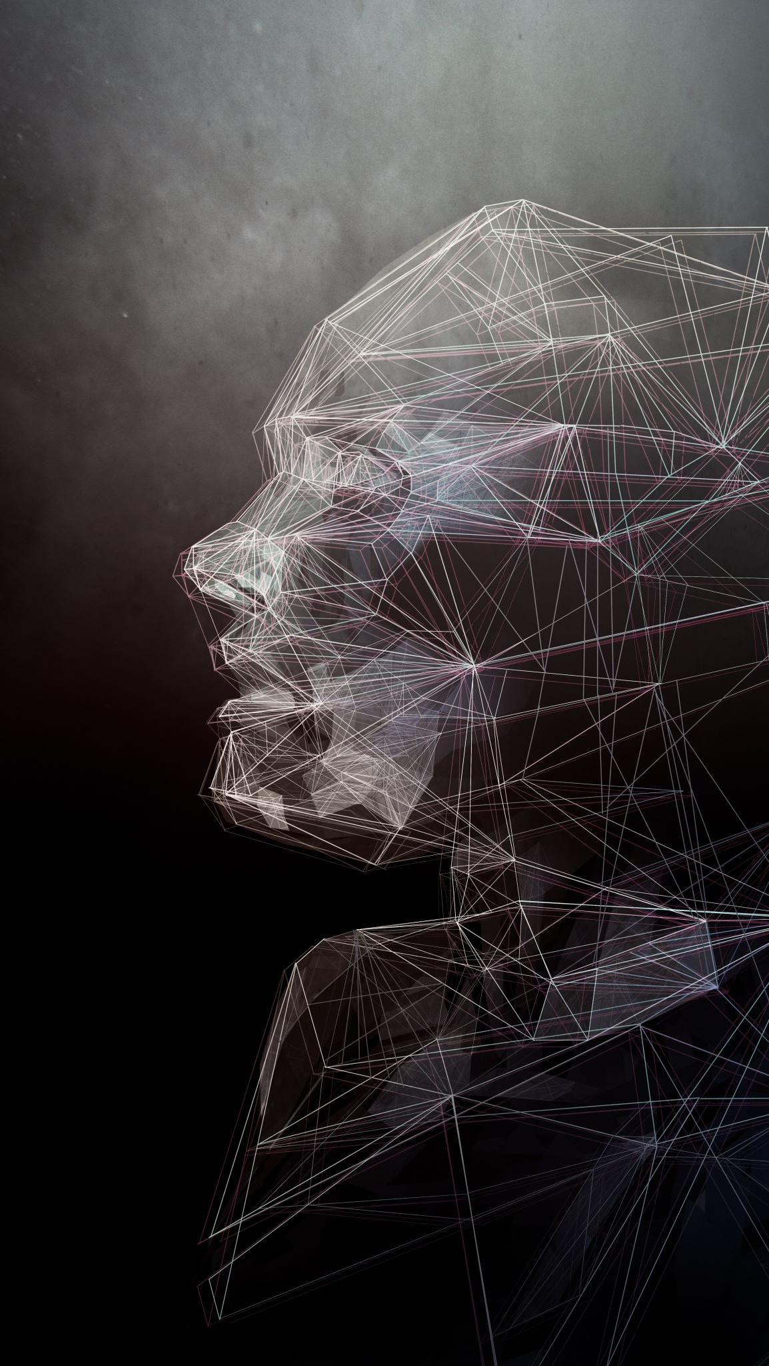
Face Recognition
In face recognition there are two types of comparisons :-
Verification –The system compares the given individual with who they say they are and gives a yes and no decision .
Identification –The system compares the given individual to all the other individuals in the database and gives a ranked list of matches .

Slide 4
Contd……..
All identification or Authentication technologies Operate using the following four stages .
Capture:- A physical or behavioral sample Is captured by the system during enrollment and, also in identification or verification process .
Extraction:- Unique data is extracted from a sample and a template is created.
Comparison:- The template is then compared with a new sample .
Match /Non-match:-The system decides if the feature extracted from the new samples are a match or non match

Slide 5
Implementation
The implementation of face recognition technology Includes the following four stages :
Image acquisition
Image processing
Distinctive characteristic Location
Template creation
Template matching

Slide 6
Image acquisition
Facial-scan technology can acquire Faces from almost any static camera Or video system that generates images of sufficient quality and resolution.
High-quality enrollment is essential to eventual verification and identification Enrollment images define the facial characteristics to be used in all future authentication events.

Slide 7
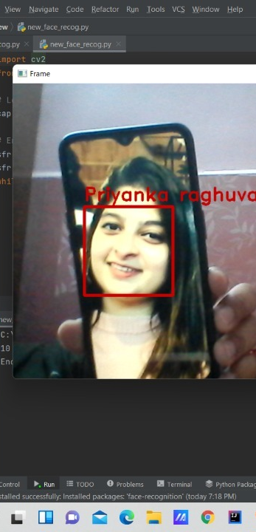
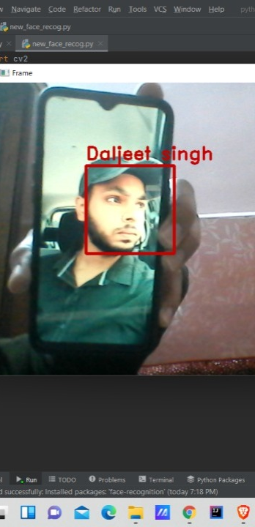
Sample Shots

Slide 8
Image Processing
Images are cropped such that the ovoid facial image remains ,and color images are normally converted to black and white in order to facilitate the initial comparisons based on grayscale characteristics.
First the presence of faces or face in a scene must be detected , it must be localized, and normalization process may be required to bring the dimensions of lice facial sample in alignment with the one of template .

Slide 9
Distinctive characteristic location
All facial scan system attempt to match Visible facial features in a fashion similar to the way people recognize one another .
The features most often utilized in facial scan systems Are those least likely to change Significantly over time : upper ridges of the eye sockets, areas around the cheekbones , sides of the mouth, nose shape , and the position of the major features related to each other .

Slide 10
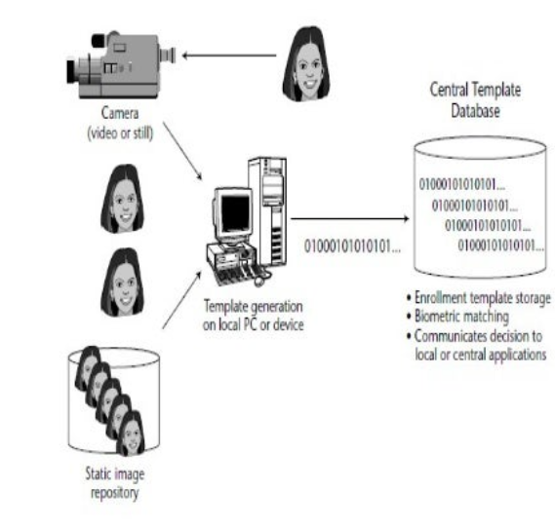
Template Creation

Slide 11
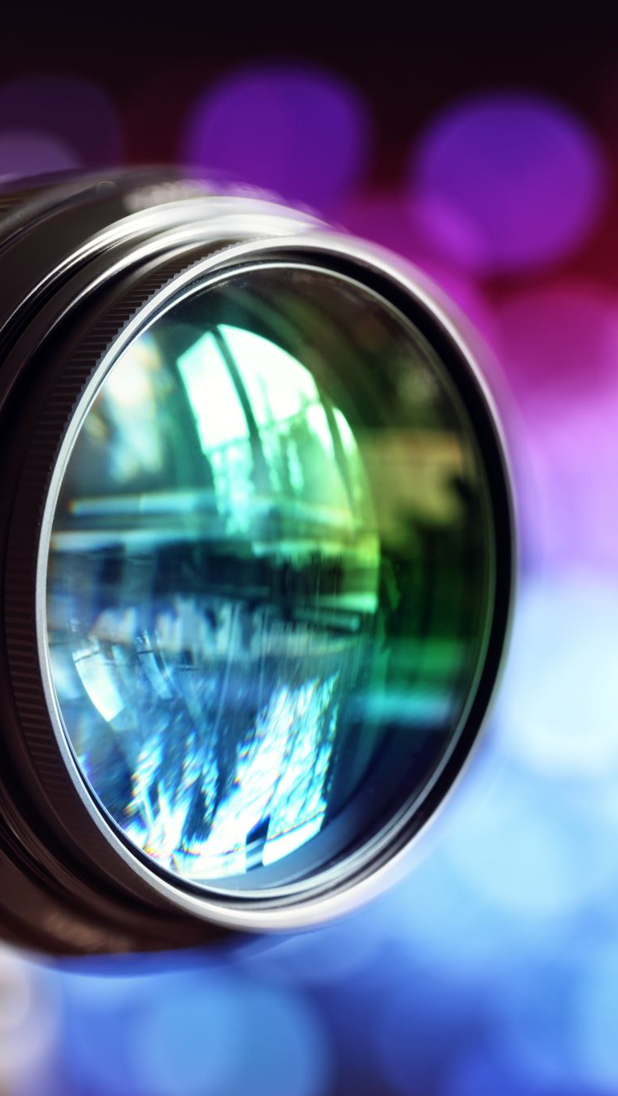
Software
Detection:- when the system is attached to a video surveillance system , the recognition system searches the field of view of a video camera for faces .If there is a face in the view , it is detected within a fraction of a second. A multi-scale algorithm is used to search for faces in low resolution . The system switches to high resolution search only after a head-like shape is detected.
Matching:- the newly acquired facial data is compared to the stored data and(ideally) linked to at least one stored facial representation .

Slide 12

Programming Language & technology used
Python
OpenCV
AI

Slide 13
Overview
PROBLEM DESCRIPTION
TRAINING STAGE
TESTING STAGE
EXPERIMENTS
CONCLUSION

